Slide 1

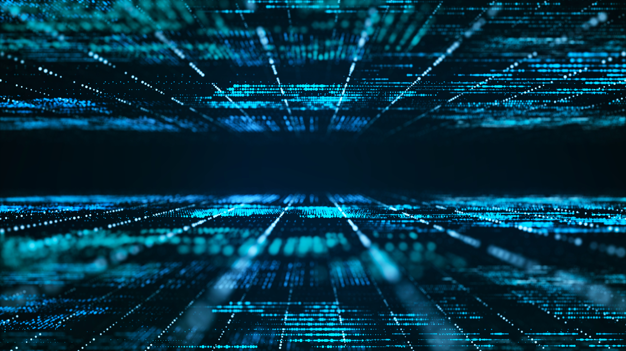
Deep Learning with Medical Images
Intervertebral Disc Segmentation at T2 MRI
Presenter : Bae Jun Ho Department of Industrial Information System, SEOULTECH ghost9023@seoultech.ac.kr

Slide 2

CONTENTS
1. Introduce Medical Image and Image Segmentation
2. Project Purpose
3. Methodology : Neural Network and Training Configuration
4. Result Analysis

Slide 3
1. Introduce
Medical Image
and
Image Segmentation

Slide 4
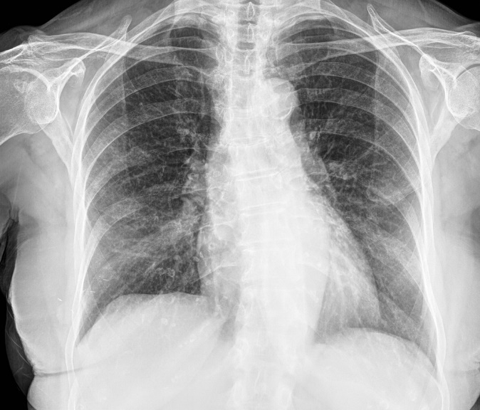
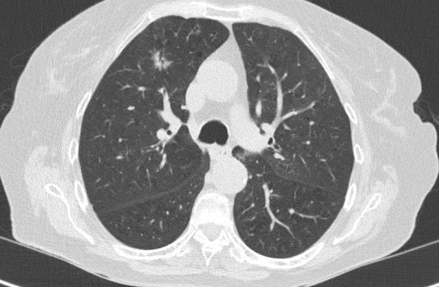
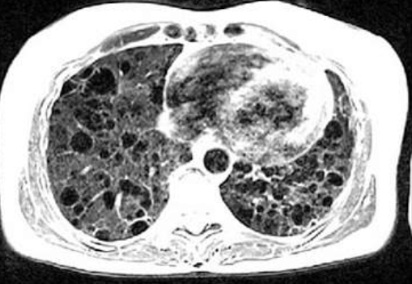
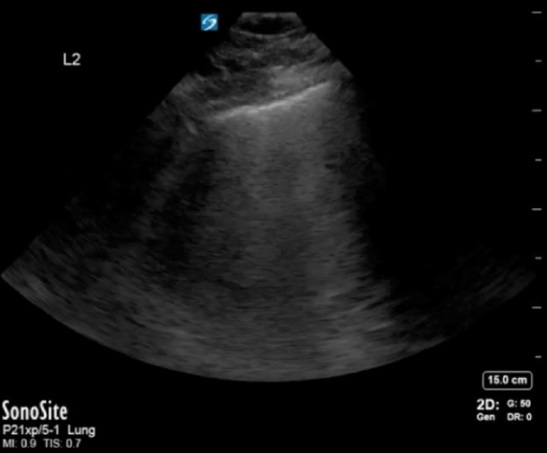
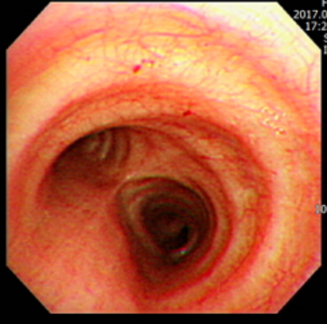
1. Introduce Medical Image and Image Segmentation
1. What Is Medical Image
Radioactive
X-ray
CT(Computed Tomography)
MRI(Magnetic Resonance Image)
US(Ultrasound)
Endoscope
4

Slide 5
1. Introduce Medical Image and Image Segmentation
1. What Is Medical Image
Non Radioactive
X-ray
CT(Computed Tomography)
MRI(Magnetic Resonance Image)
US(Ultrasound)
Endoscope
5

Slide 6
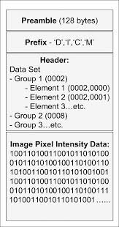
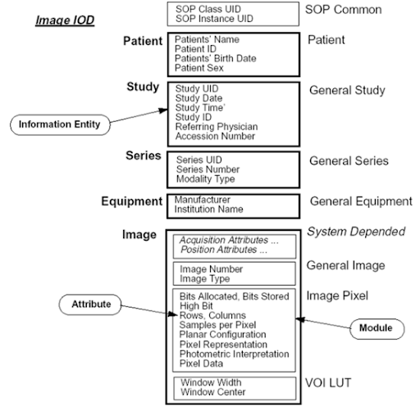
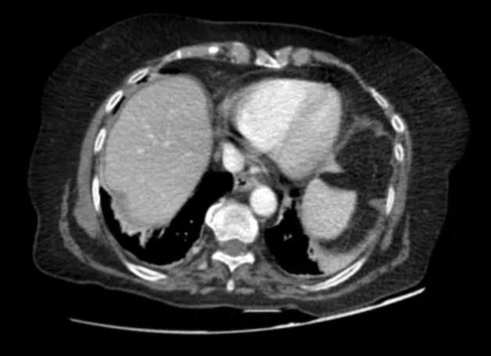
1. Introduce Medical Image and Image Segmentation
1. What Is Medical Image
Special standard format of medical image
- DICOM(Digital Imaging and Communications in Medicine)
- NIfTI(Neuroimaging Informatics Technology Initiative)
6

Slide 7
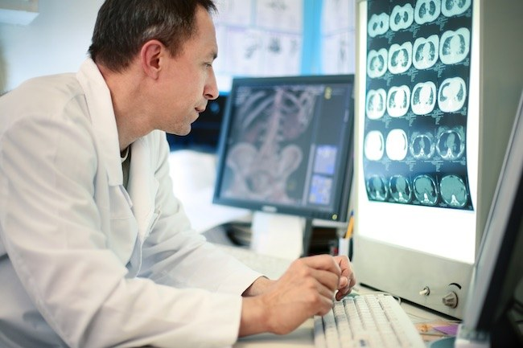
1. Introduce Medical Image and Image Segmentation
2. What Deep Learning Can Do with Medical Image
Build Algorithms to work like doctor
- Radiologist
- Specialist for each body part
- Specialist for some disease
- Robo-advising for surgery
- Discover new treatments (Research)
7

Slide 8
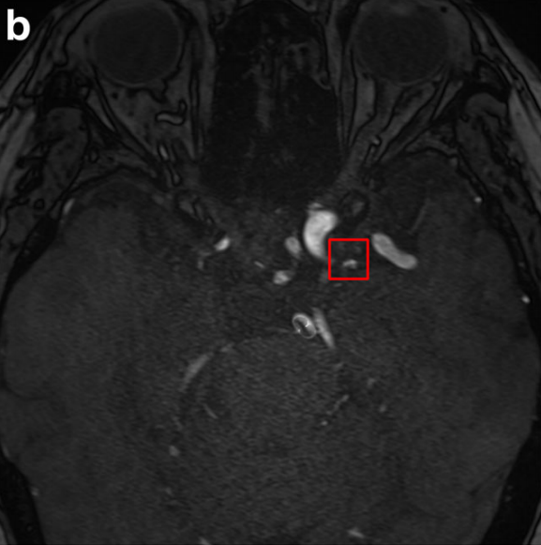
1. Introduce Medical Image and Image Segmentation
2. What Deep Learning Can Do with Medical Image
Build Algorithms to work like doctor
- Radiologist
- Specialist for each body part
- Specialist for some disease
- Robo-advising for surgery
- Discover new treatments (Research)
A deep learning algorithms may automate intracranial aneurysm detection on MR angiography
with high diagnostic performance; 2020 European Radiology, Joo, Ahn, Bae
8

Slide 9
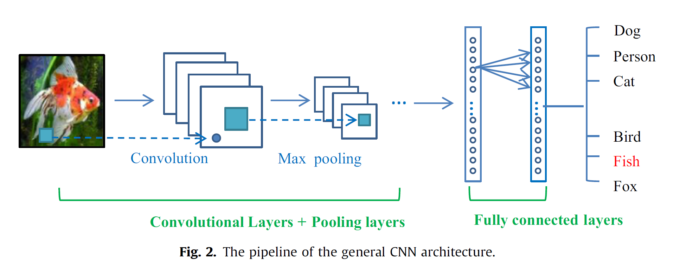
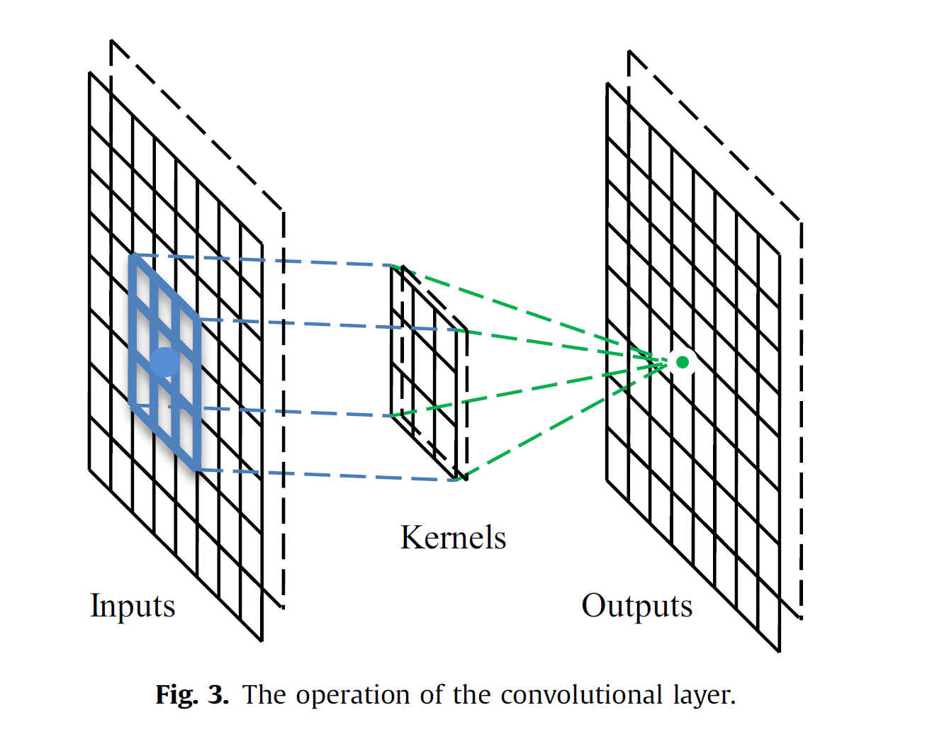
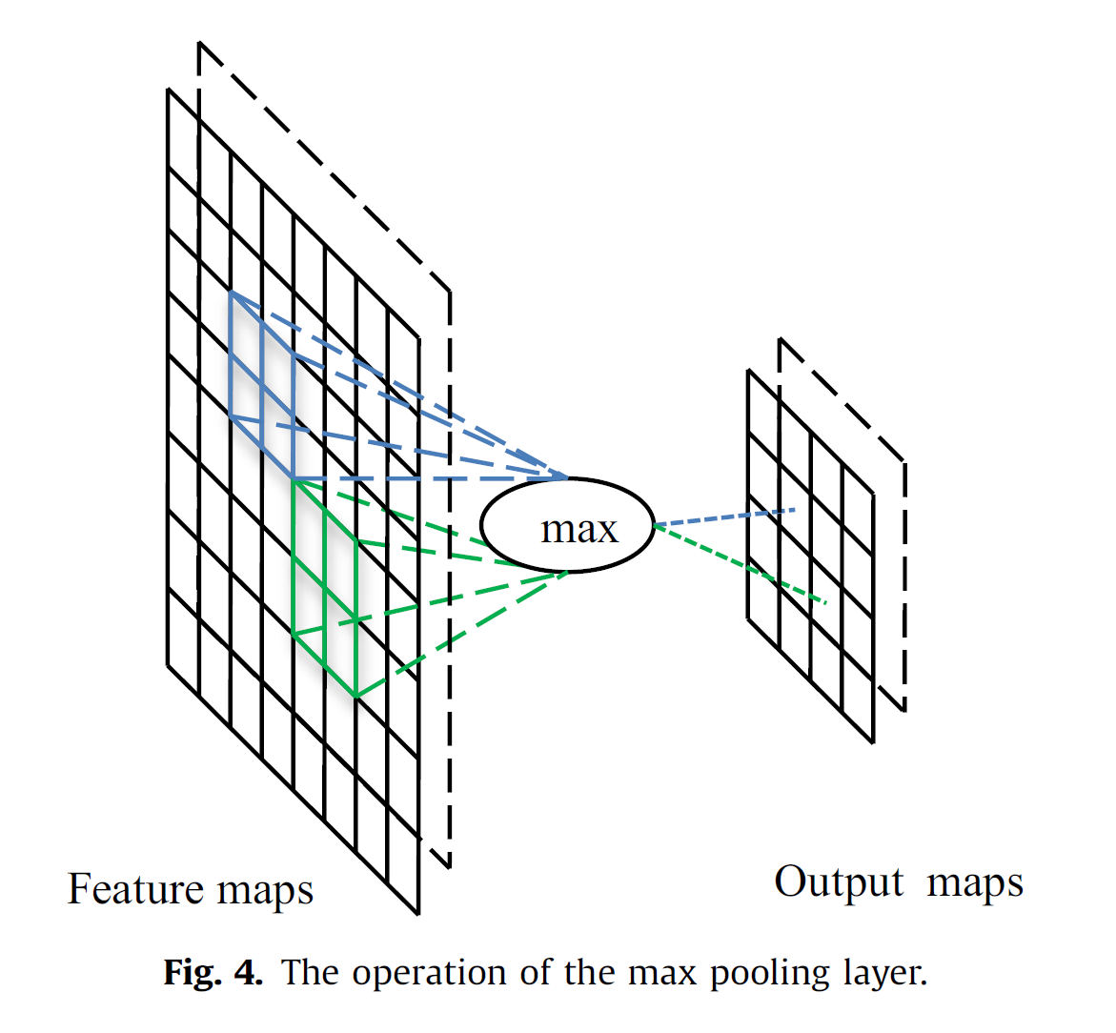
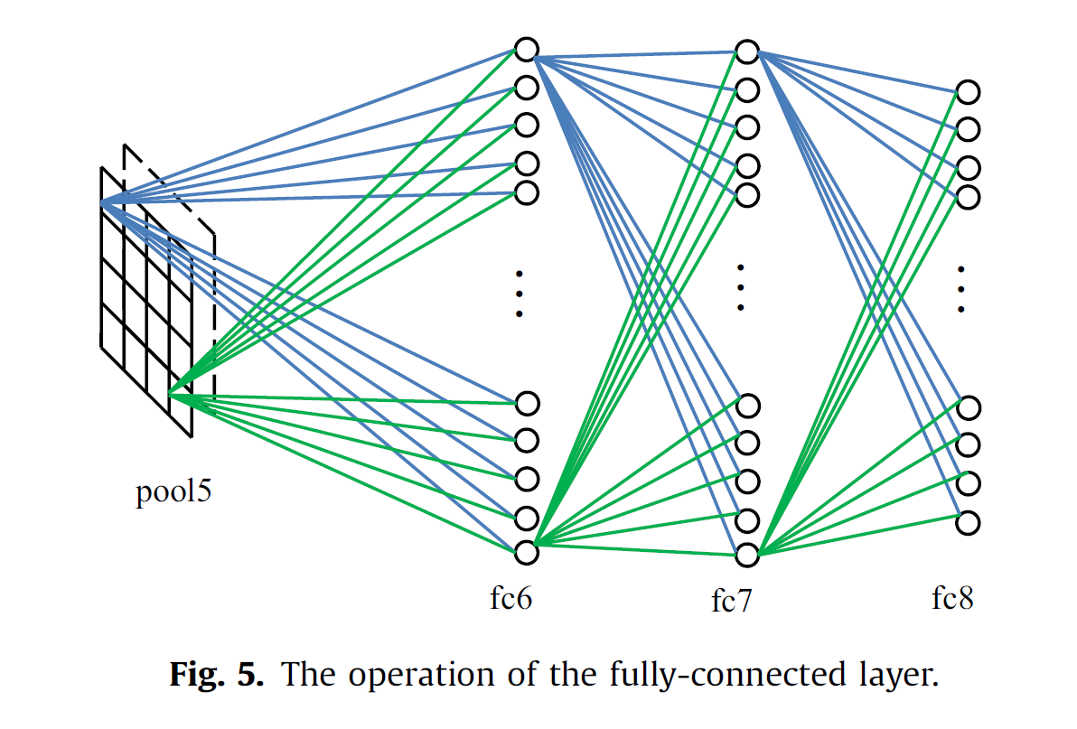
1. Introduce Medical Image and Image Segmentation
3. What is Image Segmentation
Ref. Guo et al. 2016
9

Slide 10
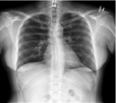
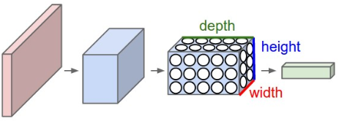
1. Introduce Medical Image and Image Segmentation
3. What is Image Segmentation
Classification
Normal (0)
or
Pneumonia (1)
Normal (0)
or
Pneumonia (1)
Input
Label
Output
10

Slide 11
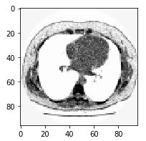
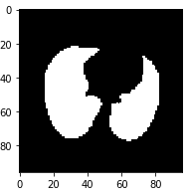
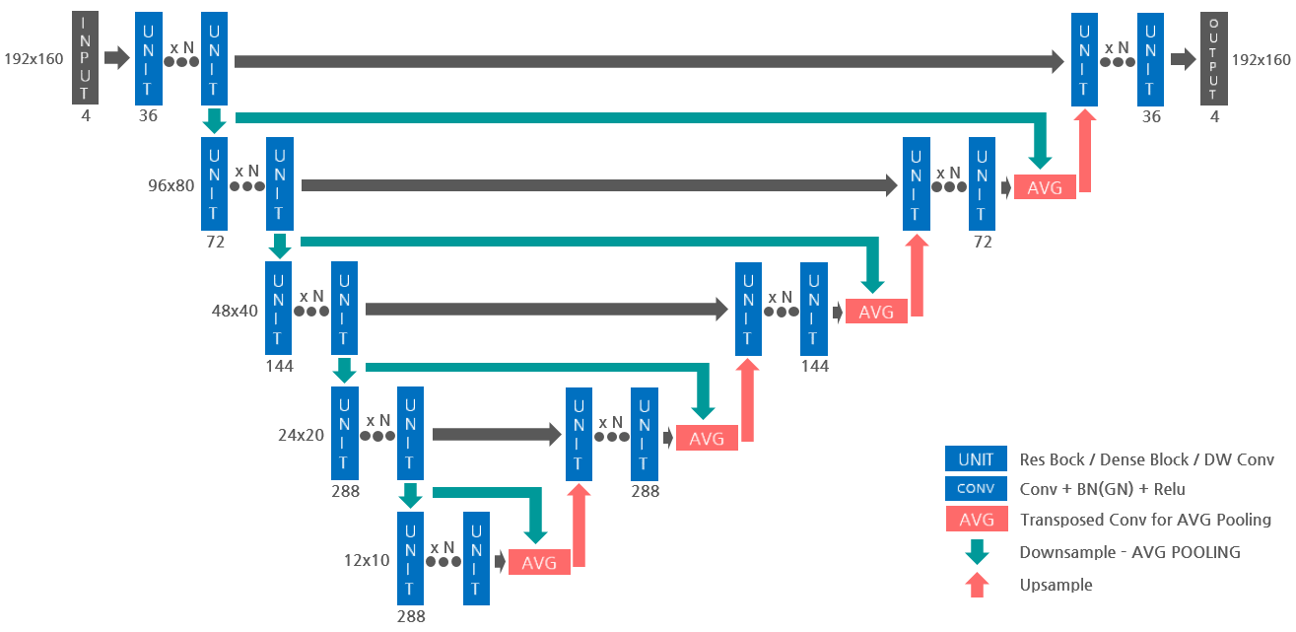
1. Introduce Medical Image and Image Segmentation
3. What is Image Segmentation
Segmentation
Input
Label
Output
11

Slide 12
1. Introduce Medical Image and Image Segmentation
3. What is Image Segmentation
Segmentaion is "Pixelwise Classification"
0
0
0
0
0
0
0
0
1
1
1
1
12

Slide 13
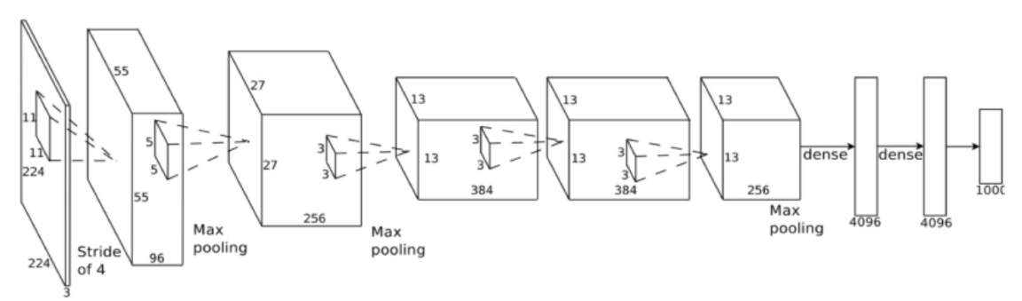
1. Introduce Medical Image and Image Segmentation
3. What is Image Segmentation
Probability of Class
0.01241
0.1 0.2 ...
0.6 0.7. 0.2 0.3
0.5 0.9 0.8
13

Slide 14
1. Introduce Medical Image and Image Segmentation
3. What is Image Segmentation
0.01241
Probability of
Each Pixel's Class
0.1 0.2 ...
0.6 0.7. 0.2 0.3
0.5 0.9 0.8
14

Slide 15
2. Project Purpose

Slide 16
2. Project Purpose
1. Project Purpose
Try Image Segmentation at medical image with Deep Learning
(Intervertebral Disc Segmentation)
To compare famous segmentation neural networks (Unet, Deeplab V3+, Custom build network)
To compare neural network parameters
(Comparing performance to change activation function, network size, learning rate, optimizer)
16

Slide 17

2. Project Purpose
2. Dataset Introduction
MRI T2 Sequence Sagittal Plane Images
Various Spine (C-spine, L-spine, T-spine)
Various Sequence (DIXON, Enhanced, TSE, qTSE)
Collected from HIRA(Health Insurance Review & Assessment Service)
17

Slide 18
2. Project Purpose
2. Dataset Introduction
Total 997 Patient Case, Around 14000 slice images
Labeled by Radiologist
Input data : DICOM file converted to PNG file
Label data : NIfTI file converted to PNG file
18

Slide 19
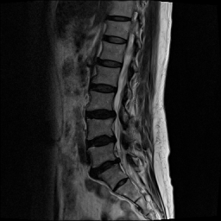
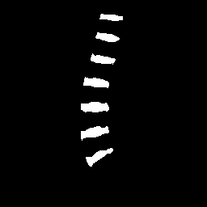
2. Project Purpose
2. Dataset Introduction
Sample of Input data and Label data
19

Slide 20
2. Project Purpose
3. Project Programming Environment
Python 3.6, Tensorflow 2.1.0(with Keras), Opencv 3.4.2 with Anaconda 3
Nvidia GTX 2080Ti 4ea, GTX 1080 2ea, RTX Titan 1ea used
* All Codes are Available at github : https://github.com/adp-study/tp
20

Slide 21
3. Methodology :
Neural Network
and
Training Configuration

Slide 22
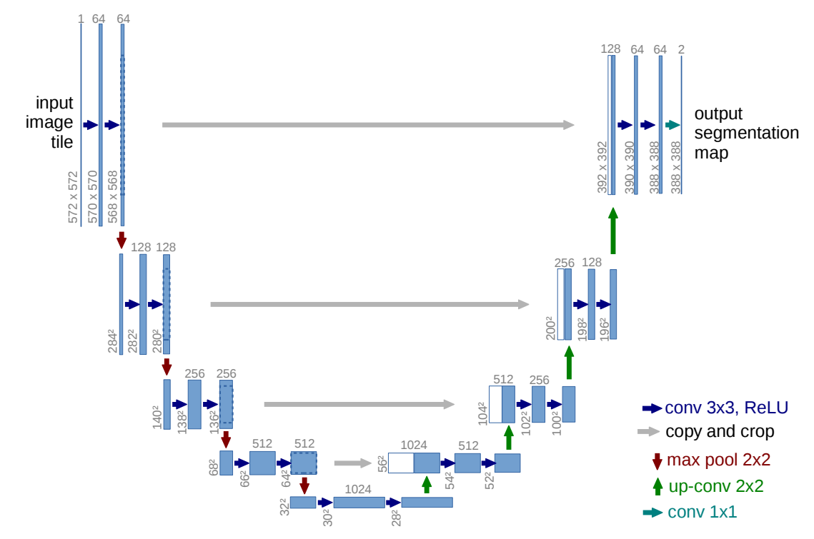
3. Methodology : Neural Network and Training Configuration
1. Network Architecture
UNet
U-Net: Convolutional Networks for Biomedical Image Segmentation; Ronneberger, Fishcer, Brox
22

Slide 23
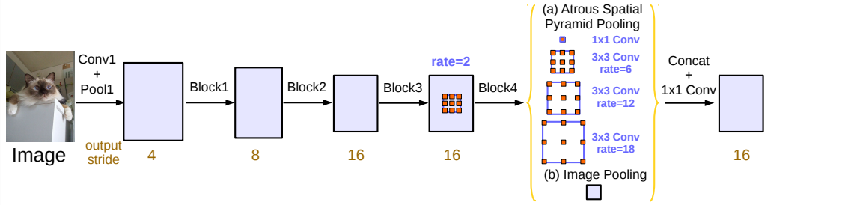
3. Methodology : Neural Network and Training Configuration
1. Network Architecture
DeepLab V3+
Rethinking Atrous Convolution for Semantic Image Segmentation; Chen, Papandreou, Schroff, Adam
23

Slide 24
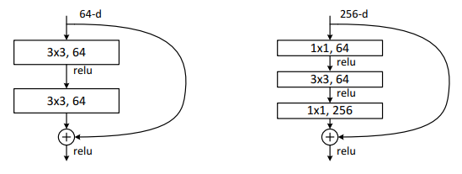
3. Methodology : Neural Network and Training Configuration
1. Network Architecture
Residual Block of ResNet
Deep Residual Learning for Image Recognition; He, Zhang, Ren, Sun
24

Slide 25
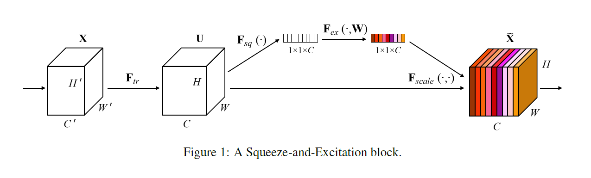
3. Methodology : Neural Network and Training Configuration
1. Network Architecture
SE Block of SENet
Squeeze-and-Excitation Networks; Hu, Shen, Albanie, Sun, Wu
25

Slide 26
3. Methodology : Neural Network and Training Configuration
1. Network Architecture
Global Average Pooling + Dense(channel reduce, relu) + Dense(channel recover, sigmoid) with Identity
SE Block
SE Block
SE Block
SE Block(Squeeze-Excitation Block)
Residual-SE Block
26

Slide 27
3. Methodology : Neural Network and Training Configuration
1. Network Architecture
3x3 Conv with
Batch Normalization
Transpose Conv
Concatenate
Upsampling Block
27

Slide 28
3. Methodology : Neural Network and Training Configuration
1. Network Architecture
Residual-SE UNet
2 Conv + Output
Downsample
Upsample
Skip Connection
28

Slide 29
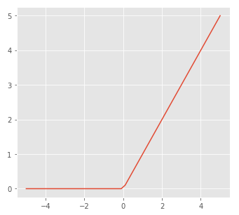
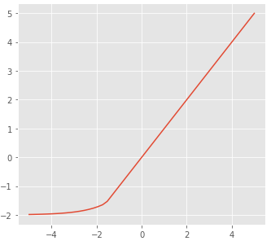
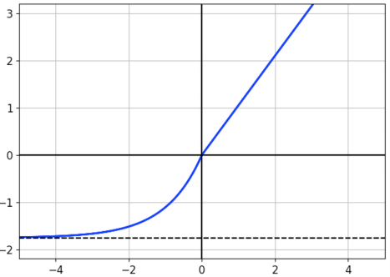
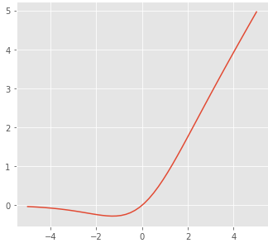
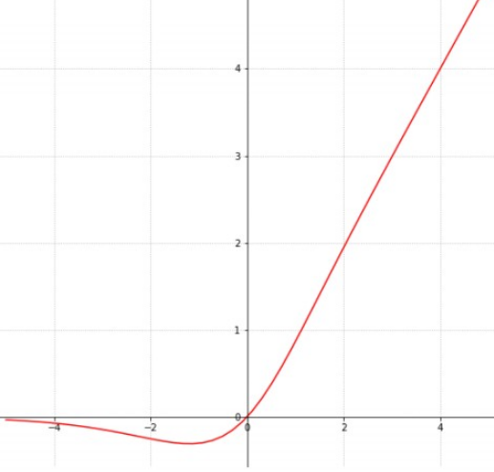
3. Methodology : Neural Network and Training Configuration
2. Network Configuration
- Activation Function : ReLU, ELU, SELU, Swish, Mish tested
- Initial Channel Size : 4, 8, 16 tested. (Above 16, OOM occurred)
- Batch Size : 4, 8, 16 tested. (Above 16, OOM occurred)
ReLU
ELU
SELU
Swish
Mish
SNDCNN: SELF-NORMALIZING DEEP CNNs WITH SCALED EXPONENTIAL LINEAR UNITS FOR SPEECH RECOGNITION; Huang, Ng, Liu, Mason, Zhuang, Liu
Mish: A Self Regularized Non-Monotonic Neural Activation Function; Misra
29
SEARCHING FOR ACTIVATION FUNCTIONS; Ramachandran, Zoph, V. Le

Slide 30
3. Methodology : Neural Network and Training Configuration
3. Training Configuration
- Loss Function : Dice Loss
- Optimizer : RMSProp, Adam, NAdam tested
- Learning rate : 1e-3, 1e-4, 1e-5 tested
- Epoch : 50, 100, 200 tested
- Image Size : (128, 128), (192, 192), (256, 256) tested
- Network : Base Unet, Base Deeplab V3+, Custom model tested
30

Slide 31
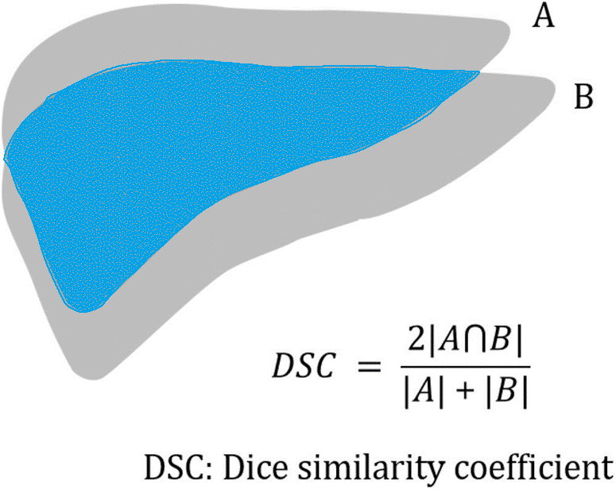
3. Methodology : Neural Network and Training Configuration
4. Performance Measurement
- Validation Loss
- Dice Coeifficient Score(DSC) (Also used for loss function)
31

Slide 32
4. Result Analysis

Slide 33
4. Result Analysis
1. Training Result
Network | Parameter Setting | mean DSC for target class
Base Unet | Input size : (128, 128), Initial Channel size 8, ReLU, 100 Epochs, NAdam with lr 1e-5 | 0.682
 | Input size : (192, 192), Initial Channel size 16, ReLU, 100 Epochs, NAdam with lr 1e-5 | 0.703
 | Input size : (256, 256), Initial Channel size 16, ReLU, 100 Epochs, RMSprop with lr 1e-4 | 0.712
Deeplab V3 + | Input size : (128, 128), Initial Channel size 8, ReLU, 100 Epochs, NAdam with lr 1e-5 | 0.646
 | Input size : (256, 256), Initial Channel size 4, ReLU, 100 Epochs, NAdam with lr 1e-5 | 0.663
Custom (Residual-SE Unet) | Input size : (256, 256), Initial Channel size 8, ReLU, 50 Epochs, NAdam with lr 1e-4 | 0.889
 | Input size : (256, 256), Initial Channel size 16, ReLU, 200 Epochs, NAdam with lr 1e-5 | 0.906
 | Input size : (256, 256), Initial Channel size 8, SELU, 200 Epochs, NAdam with lr 1e-4 | 0.742
 | Input size : (256, 256), Initial Channel size 16, SELU, 200 Epochs, NAdam with lr 1e-4 | 0.766
 | Input size : (256, 256), Initial Channel size 8, ELU, 200 Epochs, NAdam with lr 1e-4 | 0.754
 | Input size : (256, 256), Initial Channel size 8, Swish, 200 Epochs, NAdam with lr 1e-4 | 0.740
 | Input size : (256, 256), Initial Channel size 8, Mish, 200 Epochs, NAdam with lr 1e-4 | 0.738
33

Slide 34
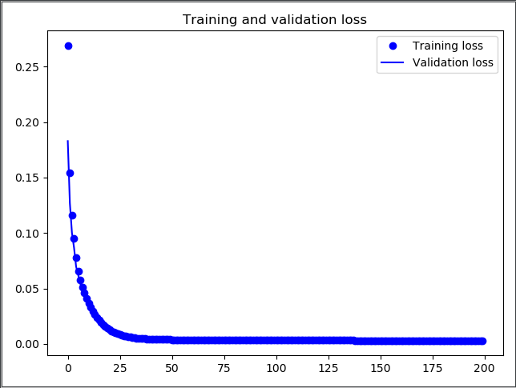
4. Result Analysis
2. Loss Graph
34

Slide 35
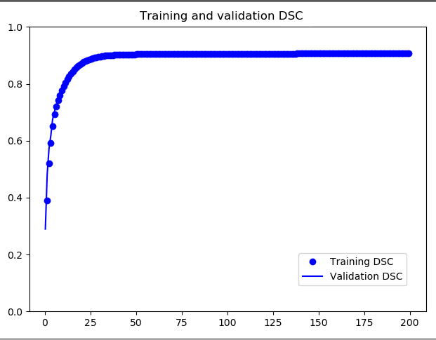
4. Result Analysis
3. DSC graph
35

Slide 36
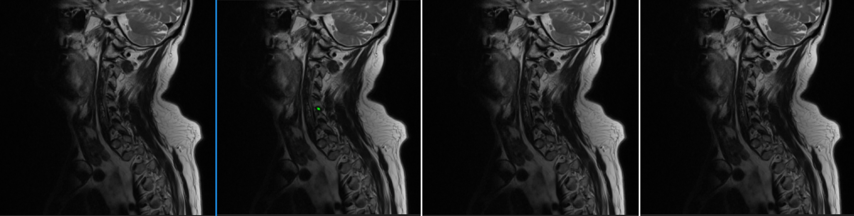
4. Result Analysis
4. Result Sample
Ground Truth
Unet
Res-SE-Unet 30 Epoch
Res-SE-Unet 116 Epoch
36

Slide 37
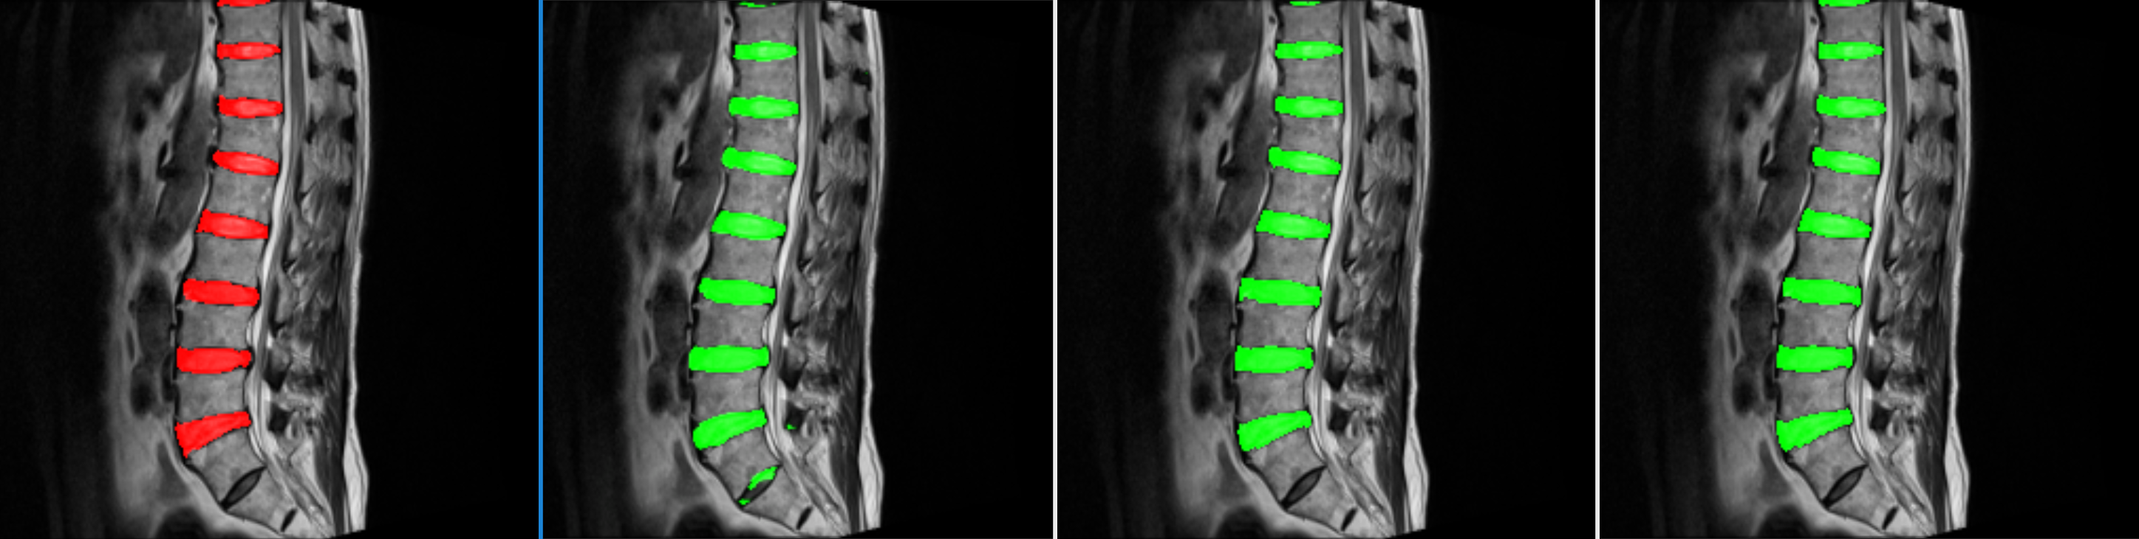
4. Result Analysis
4. Result Sample
Ground Truth
Unet
Res-SE-Unet 30 Epoch
Res-SE-Unet 116 Epoch
37

Slide 38
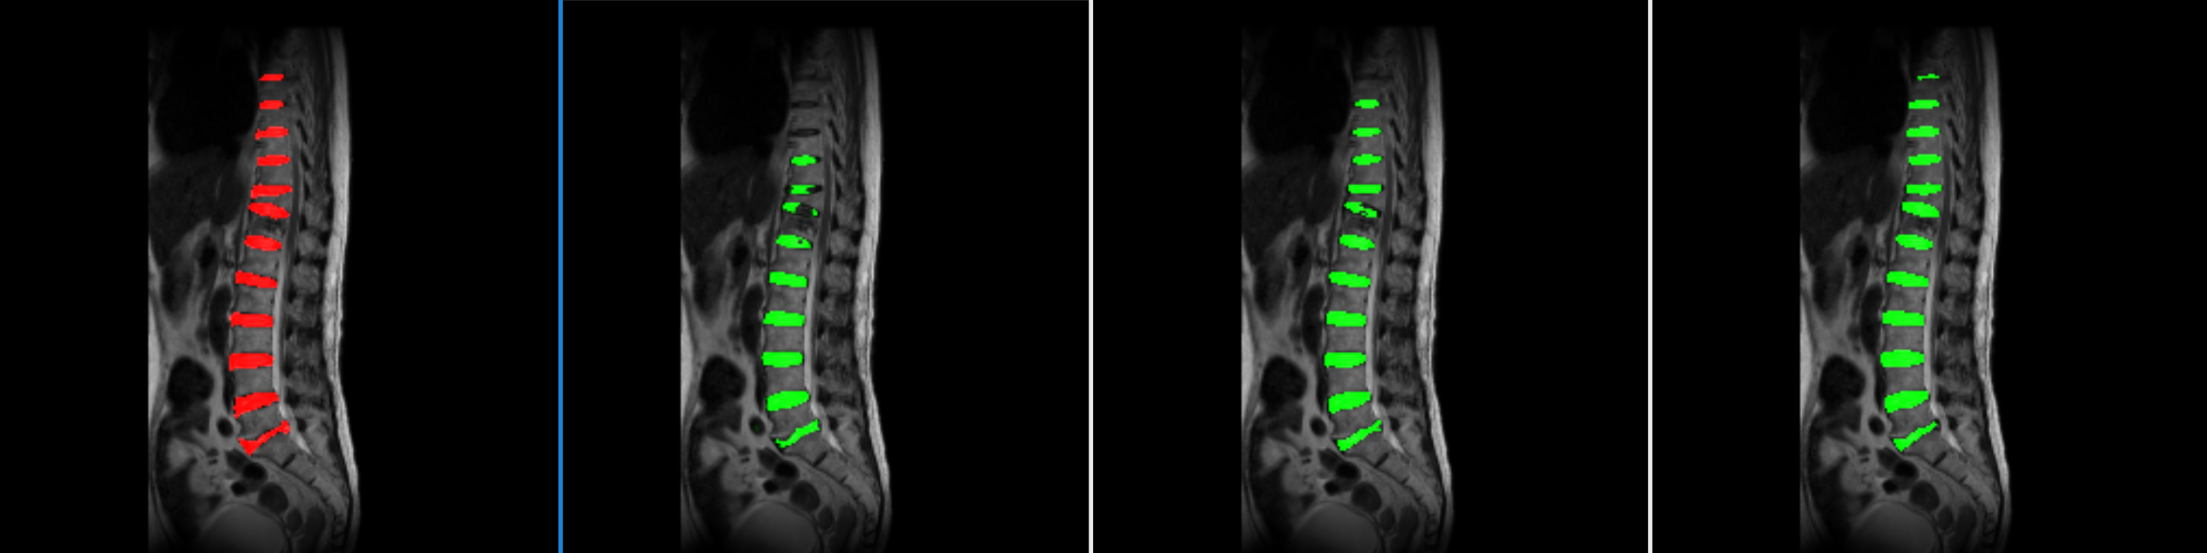
4. Result Analysis
4. Result Sample
Ground Truth
Unet
Res-SE-Unet 30 Epoch
Res-SE-Unet 116 Epoch
38

Slide 39
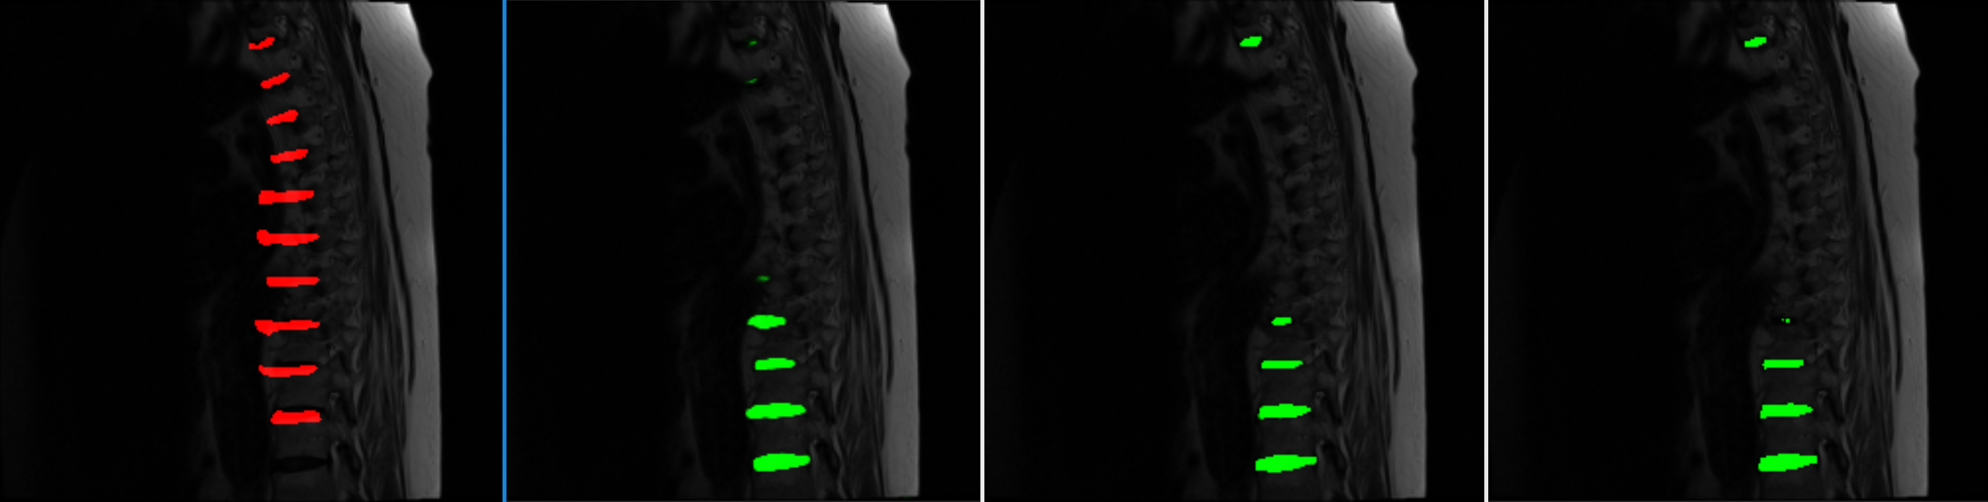
4. Result Analysis
4. Result Sample
Ground Truth
Unet
Res-SE-Unet 30 Epoch
Res-SE-Unet 116 Epoch
39

Slide 40
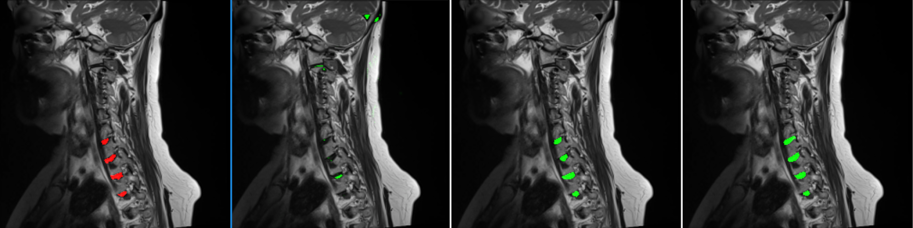
4. Result Analysis
4. Result Sample
Ground Truth
Unet
Res-SE-Unet 30 Epoch
Res-SE-Unet 116 Epoch
40

Slide 41
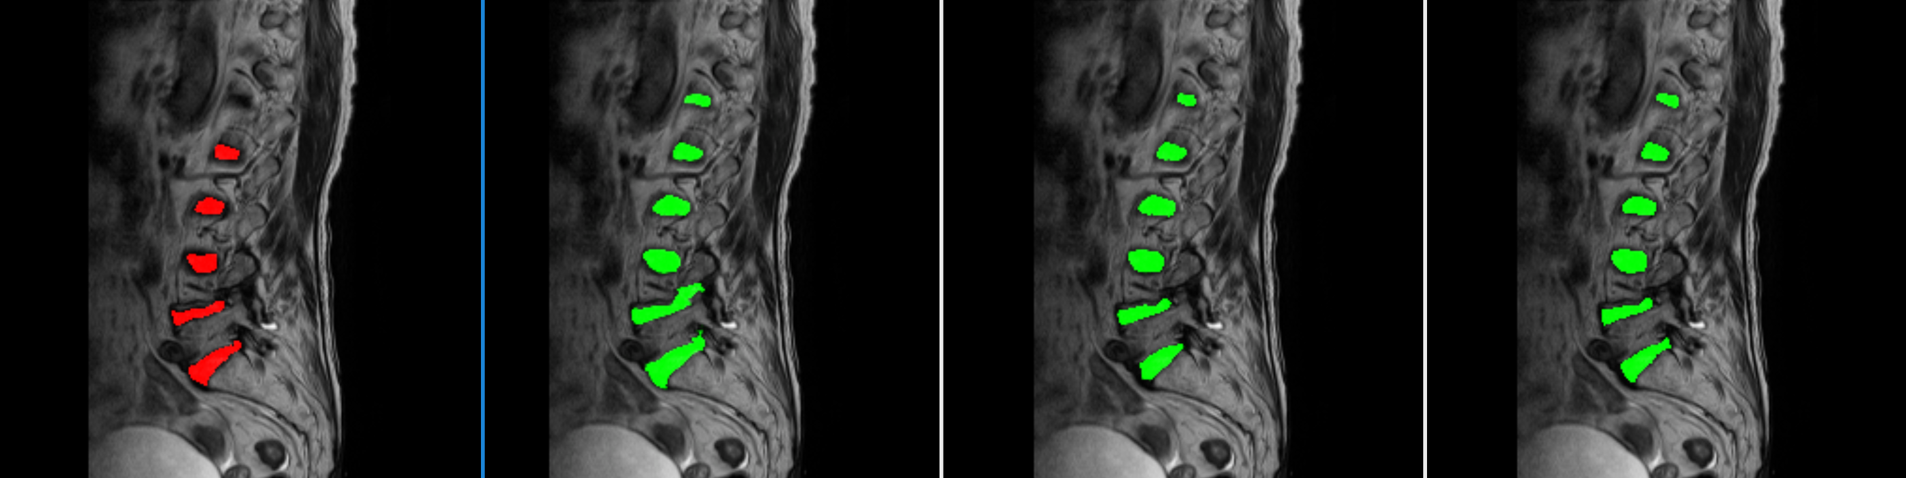
4. Result Analysis
4. Result Sample
Ground Truth
Unet
Res-SE-Unet 30 Epoch
Res-SE-Unet 116 Epoch
41

Slide 42
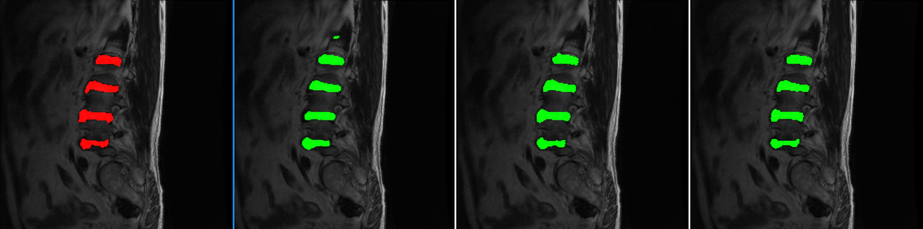
4. Result Analysis
4. Result Sample
Ground Truth
Unet
Res-SE-Unet 30 Epoch
Res-SE-Unet 116 Epoch
42

Slide 43
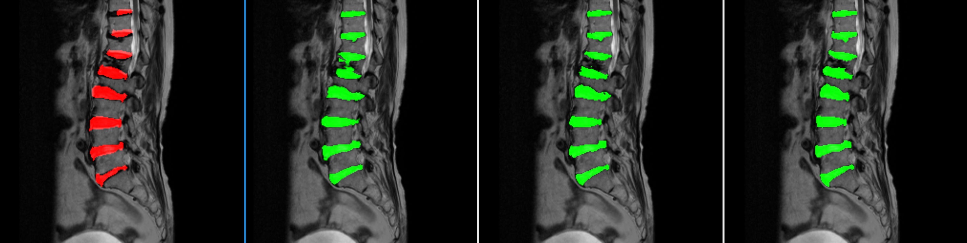
4. Result Analysis
4. Result Sample
Ground Truth
Unet
Res-SE-Unet 30 Epoch
Res-SE-Unet 116 Epoch
43

Slide 44
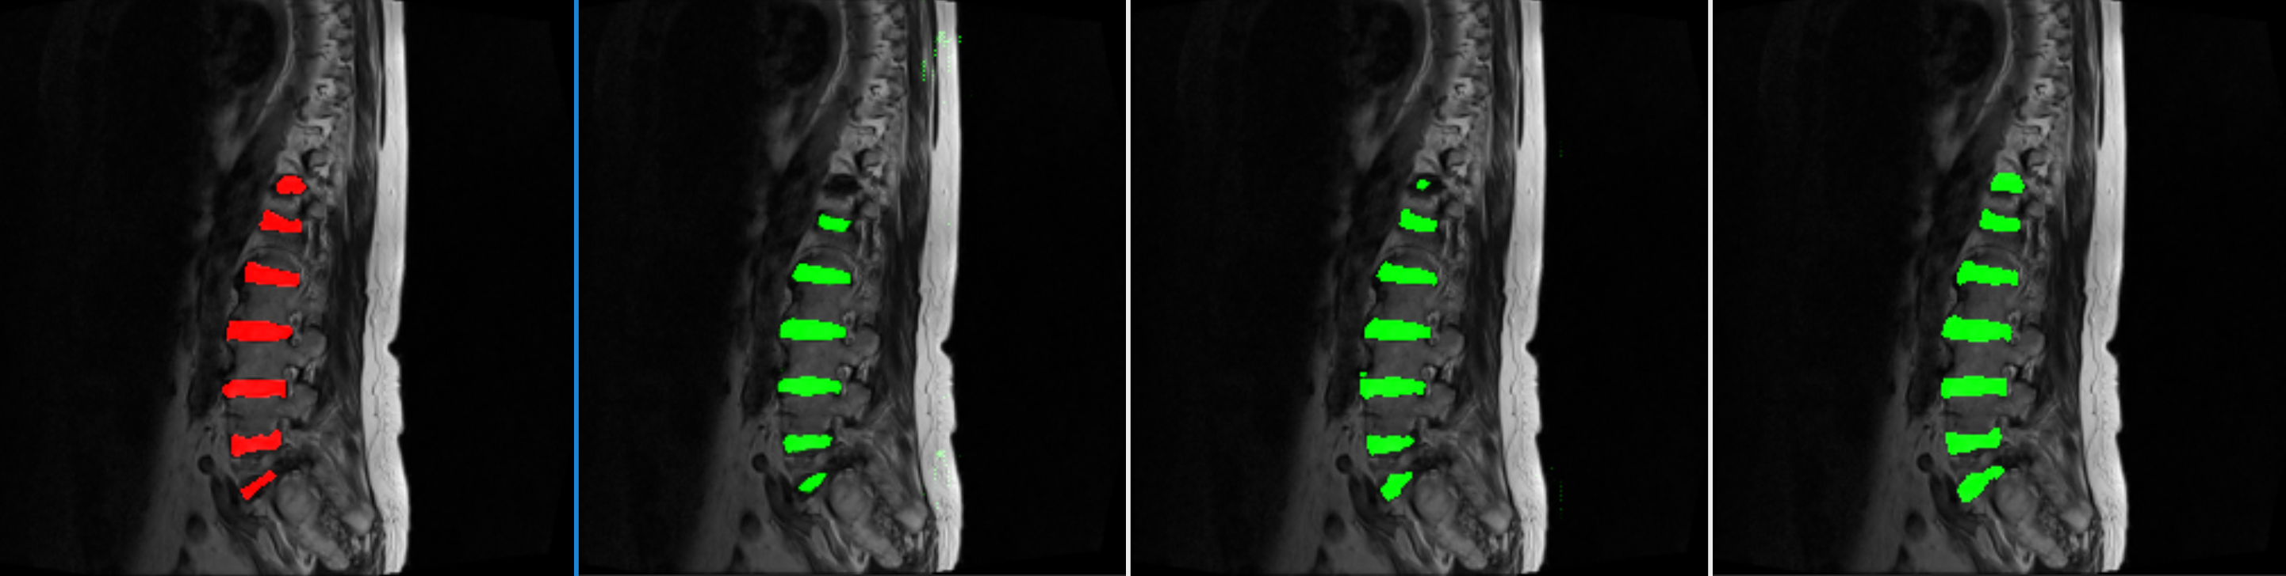
4. Result Analysis
4. Result Sample
Ground Truth
Unet
Res-SE-Unet 30 Epoch
Res-SE-Unet 116 Epoch
44

Slide 45
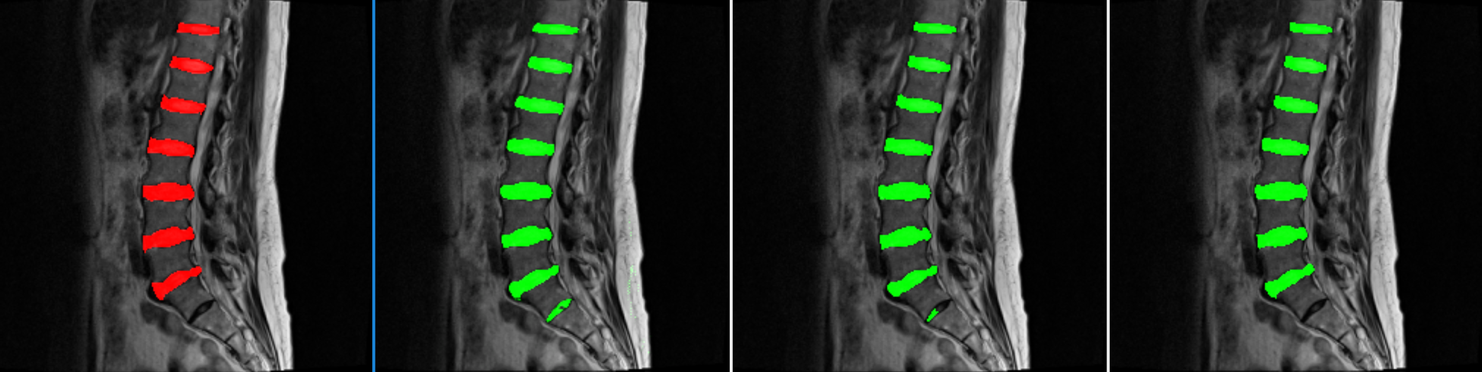
4. Result Analysis
4. Result Sample
Ground Truth
Unet
Res-SE-Unet 30 Epoch
Res-SE-Unet 116 Epoch
45

Slide 46
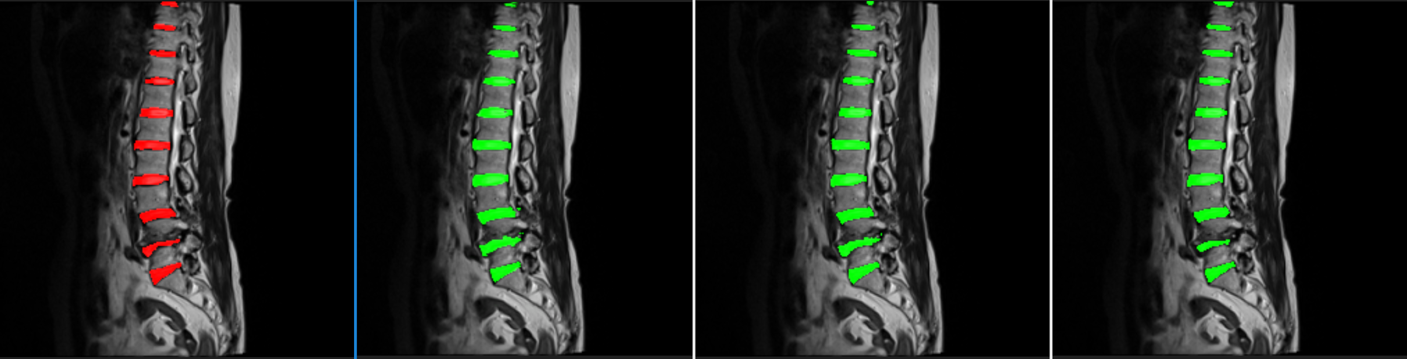
4. Result Analysis
4. Result Sample
Ground Truth
Unet
Res-SE-Unet 30 Epoch
Res-SE-Unet 116 Epoch
46

Slide 47
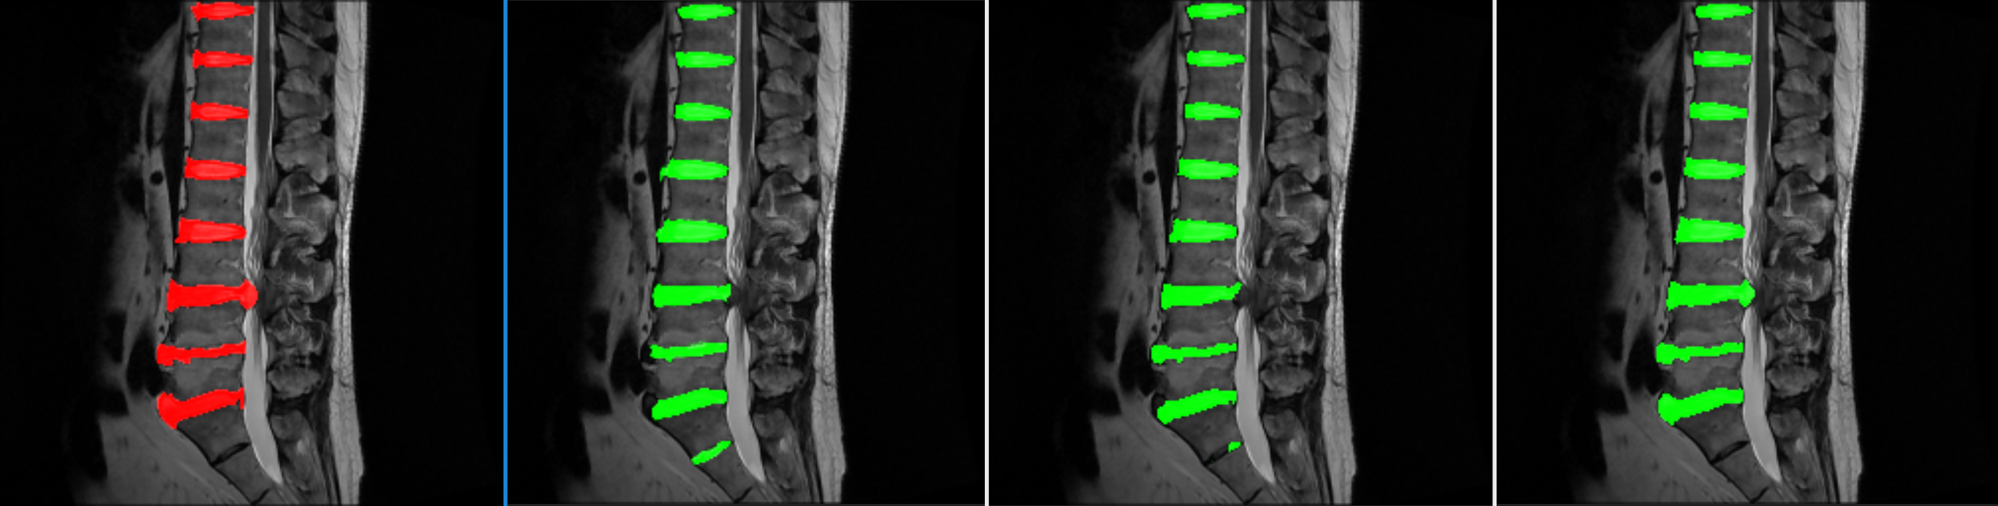
4. Result Analysis
4. Result Sample
Ground Truth
Unet
Res-SE-Unet 30 Epoch
Res-SE-Unet 116 Epoch
47

Slide 48
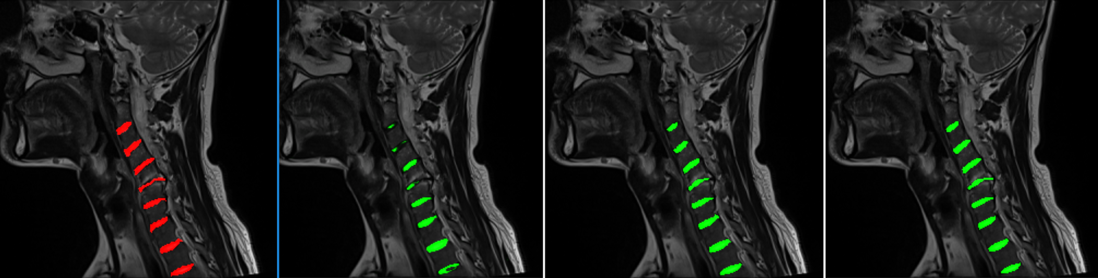
4. Result Analysis
4. Result Sample
Ground Truth
Unet
Res-SE-Unet 30 Epoch
Res-SE-Unet 116 Epoch
48

Slide 49
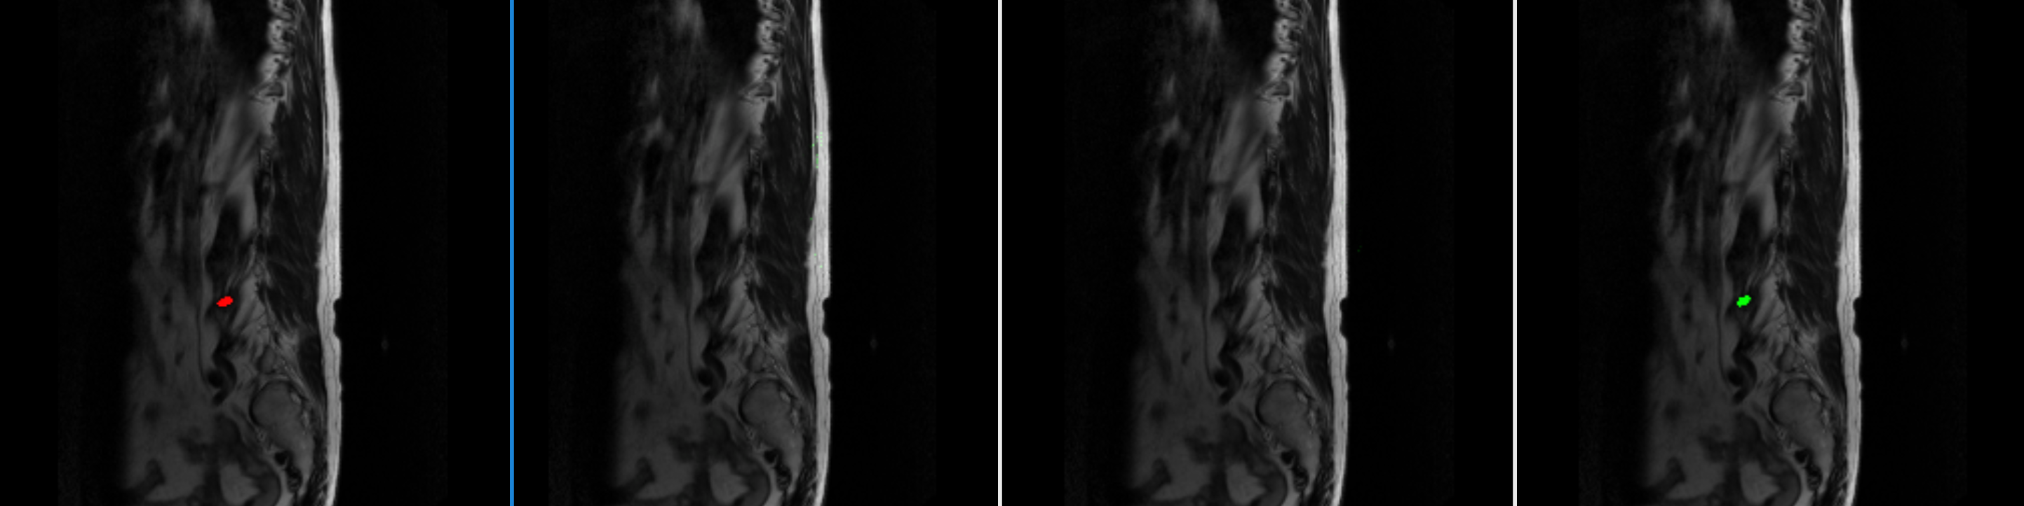
4. Result Analysis
4. Result Sample
Ground Truth
Unet
Res-SE-Unet 30 Epoch
Res-SE-Unet 116 Epoch
49

Slide 50
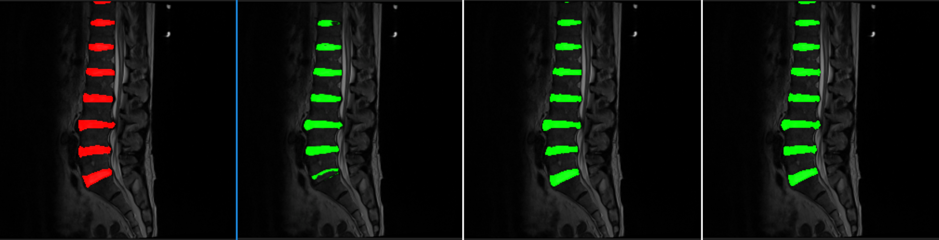
4. Result Analysis
4. Result Sample
Ground Truth
Unet
Res-SE-Unet 30 Epoch
Res-SE-Unet 116 Epoch
50

Slide 51

4. Result Analysis
4. Result Sample
Ground Truth
Unet
Res-SE-Unet 30 Epoch
Res-SE-Unet 116 Epoch
51

Slide 52
4. Result Analysis
5. Conclusion
- Modern algorithms and complex setting methods do not always give the best performance.
- If the neural network is not deep, ReLU can provide sufficient nonlinearity.
- If the quality of label data is certain, performance can be secured even with data samples with various backgrounds.
- The initial value of the neural network has a great influence on convergence, and performance can be improved even if the appropriate settings of the optimizer and learning rate have the same neural network structure and parameters.
- When image segmentation is performed with deep neural networks, decoding by minimizing information loss is a shortcut to improving segmentation results.
52

Slide 53

Q
&A

Slide 54

Thank You
* All Codes are Available at github : https://github.com/adp-study/tp

